Slide 1
Adsorption study of Rhodamin B Dye on Iraqi Bentonite and modefiedBentonite BY NanocompoundsTiO₂,ZnO,AL₂O₃ andSDS

Slide 2
دراسة امتزاز صبغة الرودامين على طين البنتونايت العراقي والبنتونايت المحسن بالمركبات النانوية

Slide 3
1. Introduction
Textile industry wastewaters cause considerable environmental problem in all world. Particularly, wastewaters containing soluble dyes must be cleaned before they discharge to nature

Slide 4
the discharge of colored wastewater even at very low concentrations from the problems such as increasing toxicity and chemical oxygen demand of the effluent, and also reducing light penetration, which has a derogatory effect on photo synthetic phenomena

Slide 5
Rhodamine B has moderate wash and light fastness properties on wool. It’s also a useful analytical reagent for the detection and determination of metals. However, the use of rhodamin B as a food color has been discontinued for a number of years on account of its suspected carcinogenic nature

Slide 6
Adsorption is an important method commonly used for cleaning of wastewater for treatment and separation of colorant in industrial processes. Bentonite⁽¹⁶⁻²¹⁾has been used directly or after modified for remove textile industry dyes from wastewater. Bentonite may be attributed to its high surface area, high chemical and mechanical stability and to a variety of surface and structural ability^{(22,23)} by surfactants to be efficient in the treatment of various pollutants

Slide 7
The aim of this Study is to examine the adsorption mechanism of Rhodamine B dyebyusing natural and modified bentonitebysodium dodecyl sulfate (SDS), Nano; TiO₂ , ZnO and Al₂O₃.

Slide 8
The surfactant, sodium dodecyl sulfate and bentonitewas prepared by insertion of SDSbetween the layers of the bentonite by a simple anionic exchange. Another modification was used in this study involved adding three Nano composite; ZnO, Al₂O₃ and TiO₂ to increase the adsorption bentonite surface area and modified adsorption surface ability and to find out the applicability to textile wastewaters

Slide 9
2. Materials and Methods 2.1. Adsorbent
The bentonite clay was supplied from the state company for geological survey and mining – Iraq. The bentonite had the following composition with particle size less than 75 µm.
The molecular formula of bentonite could be written as:
Mg₂Al₁₀Si₂₄O₆₀(OH)₁₂[Na,Ca]

Slide 10
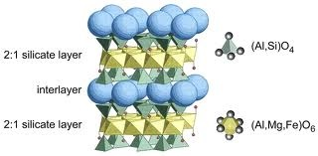

Slide 11
2.1.2. Preparation of the modified bentonite.
Preparation of modified benonite involves mixing different weight 0.01, 0.05 and 0.1 g of modifier SDS, Nano TiO₂, ZnOand Al₂O₃ with 10 g of natural bentonite and 100 mLof deionized water. This content was shake about 3 hr.and then separated and dried.

Slide 12
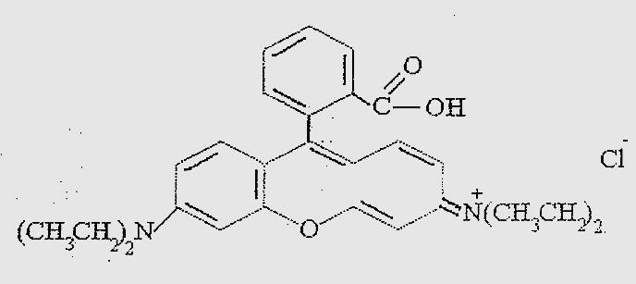
2.2 Adsorbate

Slide 13
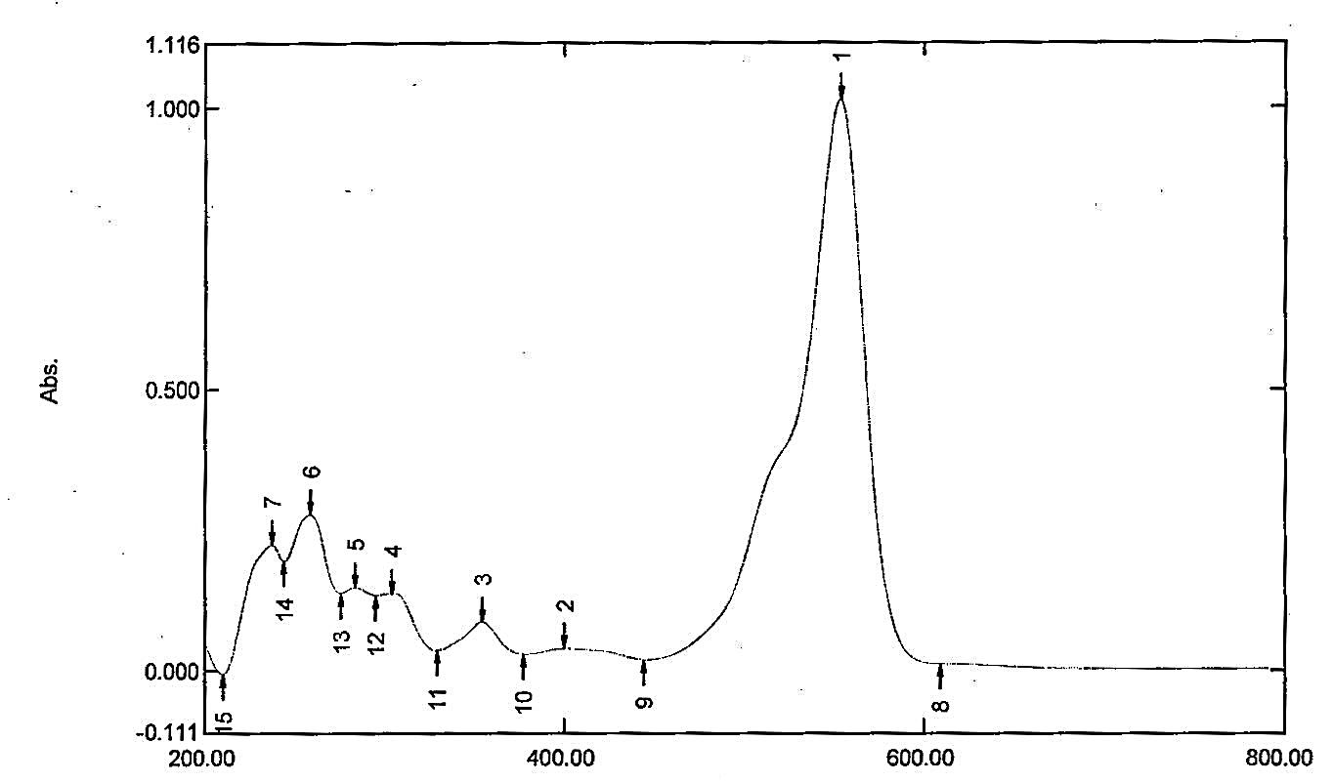
Fig.1.UV-Visible absorption spectrum for Rhodamine B dye with concentration
10 mg/ L

Slide 14
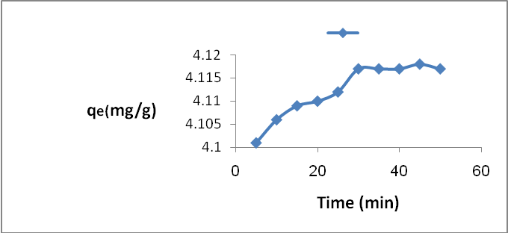
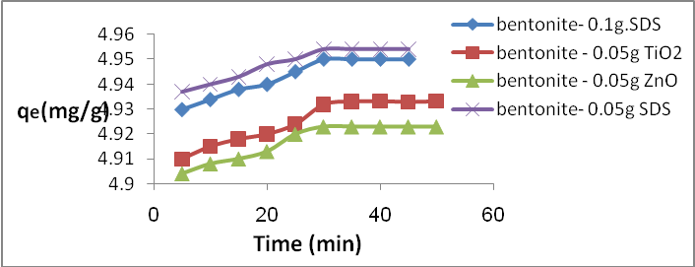
Effect of contact time on Rhodamine B adsorption on; (A) natural bentonite
(B)Modifiedbentonite

Slide 15
3.2. Effect of adsorbent dose
 | Romovalpercentage(%R)
Dose of adsorbent (g) | Natnralbentonite | B-0.05g TiO₂ | B-0.05g ZnO | B-0.05g SDS | B-0.1g SDS
0 | 0 | 0 | 0 | 0 | 0
0.1 | 20.7 | 25.3 | 25.3 | 30.7 | 23.8
0.2 | 45.5 | 52.3 | 50.5 | 48.2 | 52.3
0.3 | 69.3 | 75.2 | 75.0 | 80.1 | 82.4
0.4 | 80.1 | 95.21 | 94.6 | 92.3 | 90.7
0.5 | 82.3 | 98.6 | 98.4 | 99.0 | 99.0
1.0 | 82.3 | 98.6 | 98.6 | 98.6 | 99.0

Slide 16
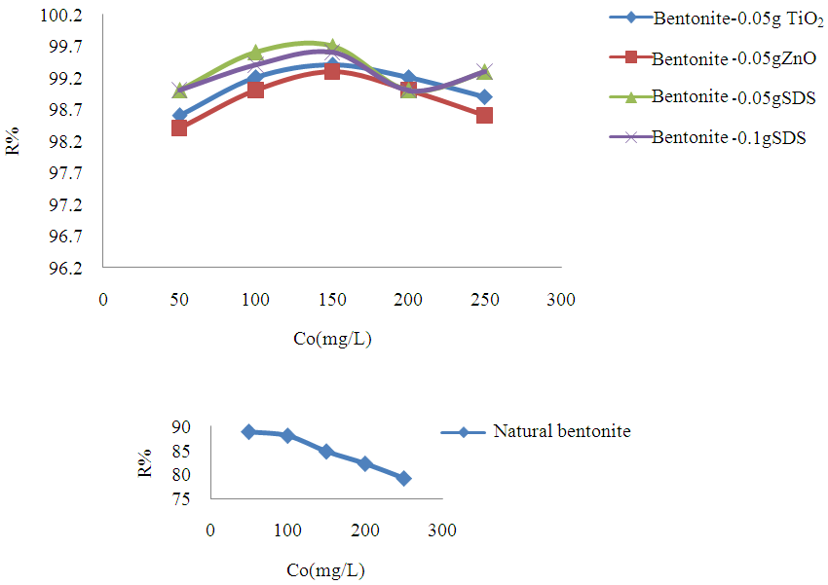
3.3 Effect of adding different amount of SDS and NanoTiO₂ ,ZnO
andAl₂O₃ on the removal percentage.
.Effect of adding different amount of modifier to bentonite on Removal percentage of Rhodamine B

Slide 17
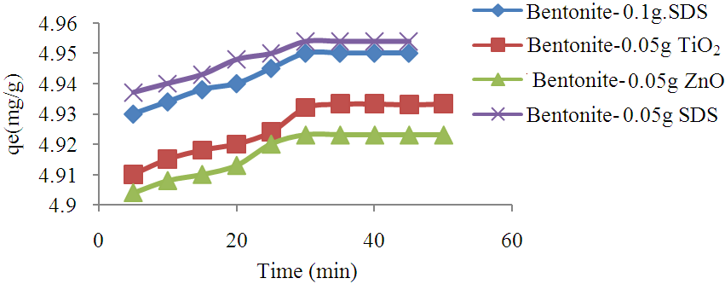
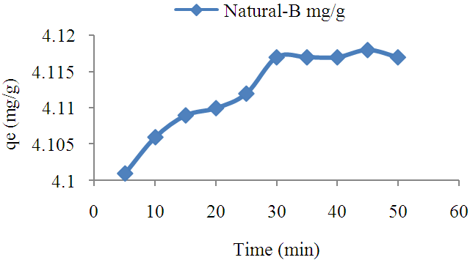
.
3.1. Effect of Contact Time.

